Slide 1
7.4 Lookback Options
指導教授：戴天時
報告者：陳博宇

Slide 2
章節結構
7.4.1 Floating Strike Lookback
7.4.2 Black-Scholes-Merton Equation
7.4.3 Reduction of Dimension
7.4.4 Computation of the Price of the
Lookback Option

Slide 3
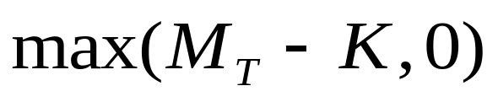
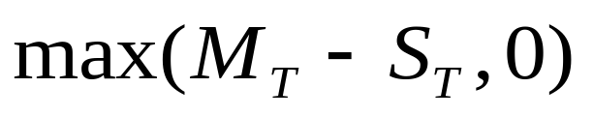
Introduction
Lookback option: An option whose payoff is Based on the
maximum that the underlying asset price attains over some
interval of time prior to expiration.
Lookback option Fixed Strike Lookback Option
Floating Strike Lookback Option

Slide 4
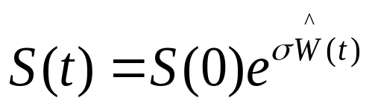
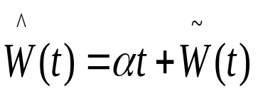
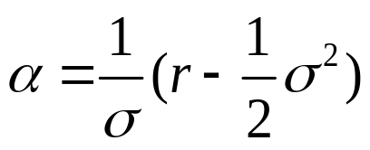
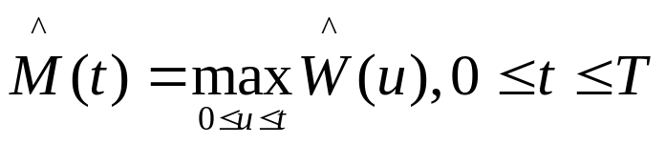
7.4.1 Floating Strike Lookback Option
The payoff of this option is the difference between the
maximum asset price over the time between initiation and
expiration and the asset price at expiration.
We begin with a geometric Brownian motion asset price,
which may be written as
where , .
With

Slide 5
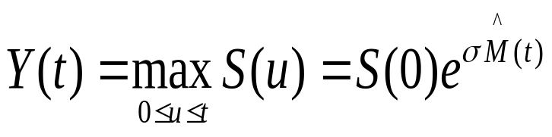
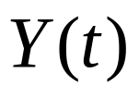

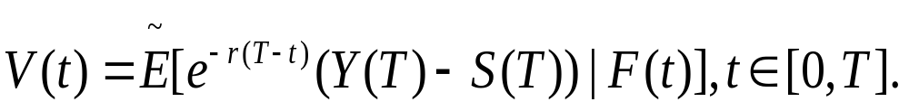

We define the maximum of the asset price up to time t as
, .
The payoff is V(T)=Y(T)-S(T) at expiration time T.
This payoff is nonnegative because Y(T) S(T).
We also define the risk-neutral price of the lookback option
Is
Because the pair of processes (S(t),Y(t)) has the Markov
property , there must exist a function v(t, x, y) such that

Slide 6
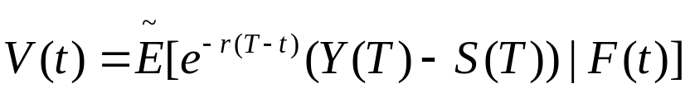
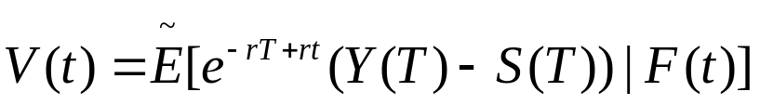

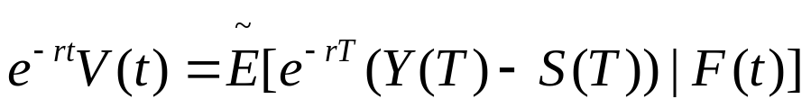
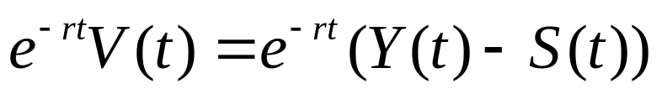
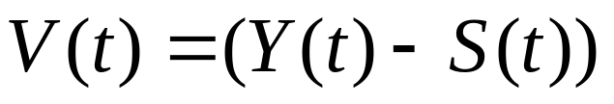


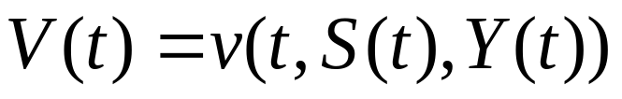
已知 是martingale,
所以
將 移至左邊
Martingale的性質
因為(S(t),Y(t))有Markov特性，所以可將 寫成

Slide 7
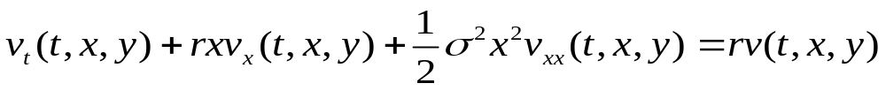

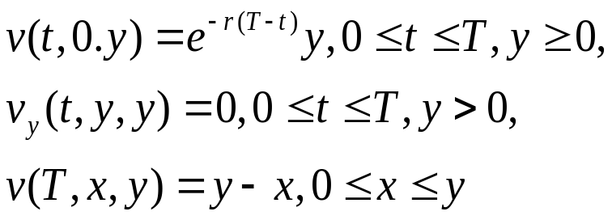
7.4.2 Black-Scholes-Merton Equation
Theorem 7.4.1 Let v(t, x, y) denote the price at time t of
the floating strike lookback option under the assumption
that S(t) = x and Y(t) = y . Then v(t, x, y) satisfies the
Black-Scholes-Merton partial differential equation
In the region
and satisfies the boundary conditions

Slide 8
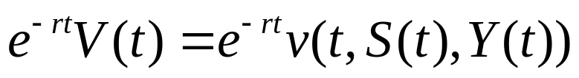


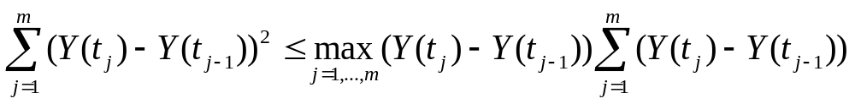
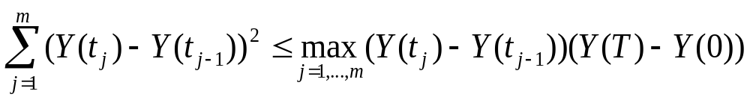
證明前所需作的準備
We have to proof dY(t)dY(t)=0 , dY(t)dS(t)=0 .
Y(t) is continuous and nondecreasing in t.
Iterated conditioning implies that
Is a martingale under .
Let be a partition of [0,T ].Then
,
We conclude that Y(t) accumulates zero quadratic variation
on [0, T], a fact we record by writing dY(t)dY(t) =0.

Slide 9
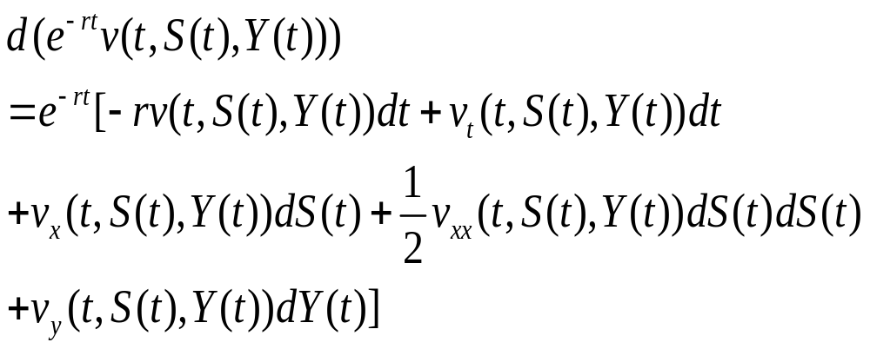
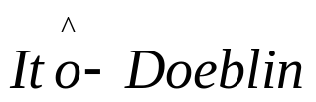
This argument shows that on any interval in which a
function is continuous and nondecreasing, it will
accumulate zero quadratic variation.
Fortunately, we can work with the differential of Y(t).
We have already argued that dY(t)dY(t)=0. Similarly, we
have dY(t)dS(t)=0 .
Proof of Theorem 7.4.1
by formula
dY(t)dY(t)=0 , dY(t)dS(t)=0.

Slide 10
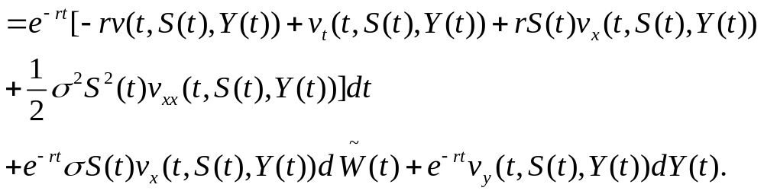
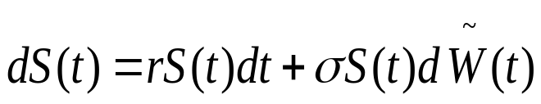
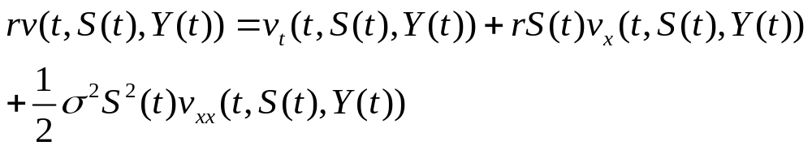
In order to have a martingale, the dt term must be zero, and
this gives us the Black-Scholes-Merton equation
得證，另外dY(t)項也必需為０，因為martingale的性質。

Slide 11

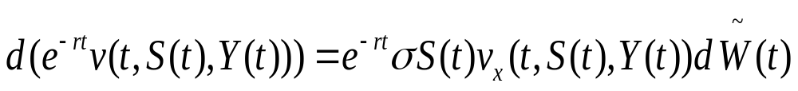
The dY(t) term is naturally zero when S(t) <Y(t) . However ,
at the times when Y(t) increases, which are the times when
S(t) = Y(t), the term must be zero because
dY(t) is positive .
Remark 7.4.2

Slide 12
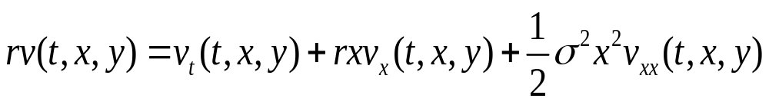
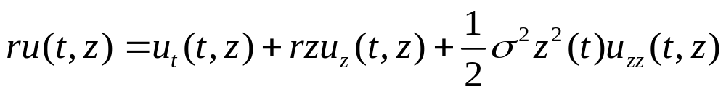
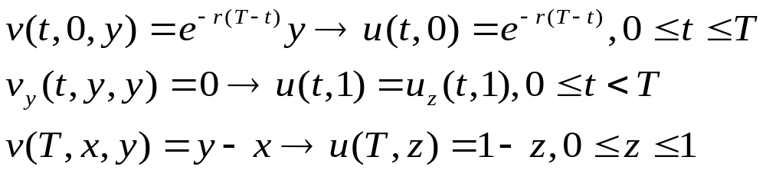
7.4.3Reduction of Dimension
由於後來我們所設的v(t, x, y)函數有三個變數，若能藉由x跟
y的特性就可以減化其變數了。

Slide 13
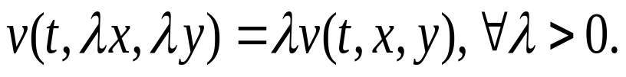

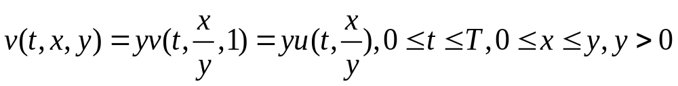
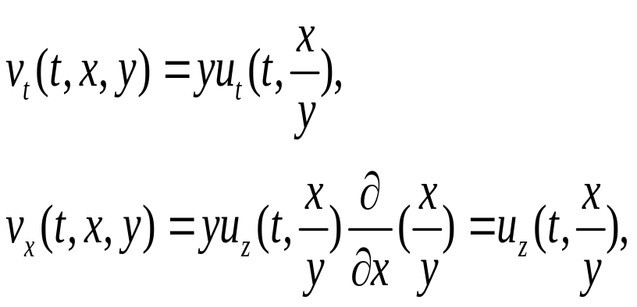
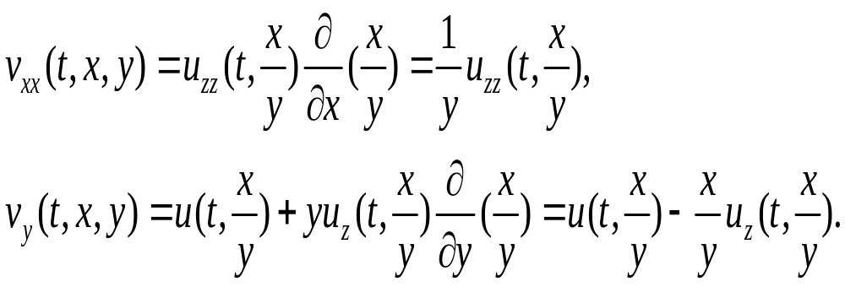
The price of the floating strike lookback option has a
linear scaling property
This is because scaling both S(t) and Y(t) by the same
positive constant at a time t prior to expiration results in the
payoff Y(T)-S(T) being scaled by the same constant.
We define ,
we can compute the partial derivatives:

Slide 14
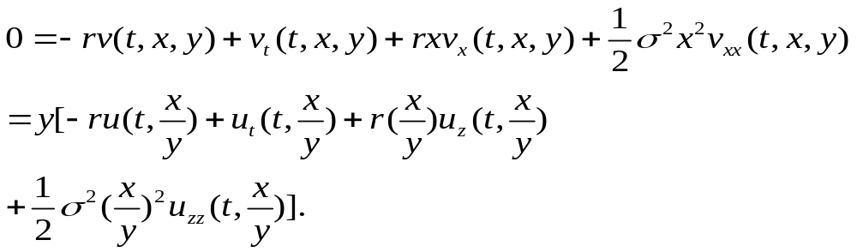
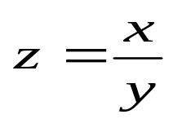
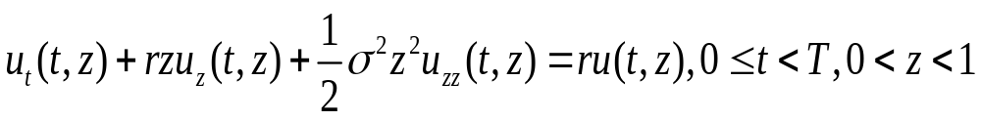
代入上一頁的部分微分
且 ，所以可得知

Slide 15
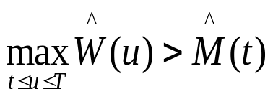
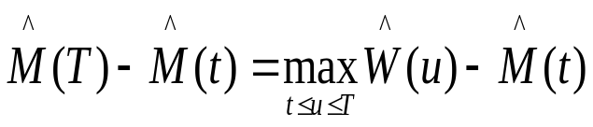
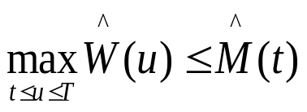
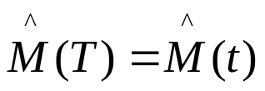

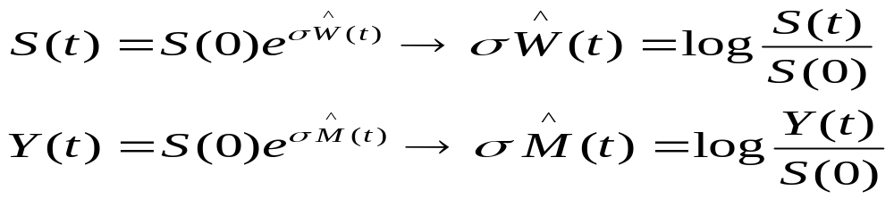
7.4.4Computation of the Price of the Lookback Option
If ,then
Else if ,then and .
We have

Slide 16
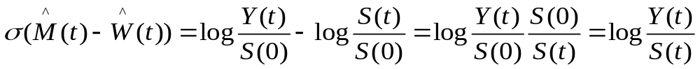
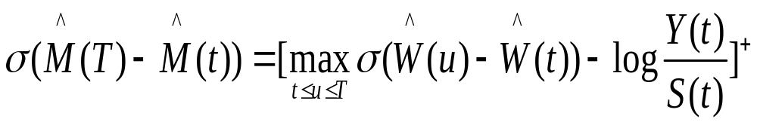

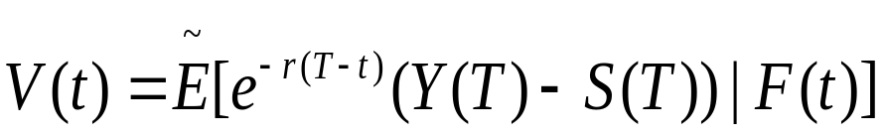
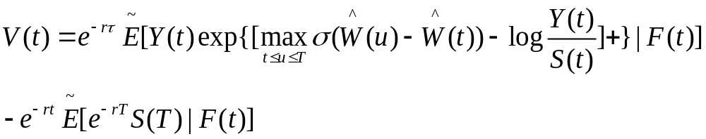
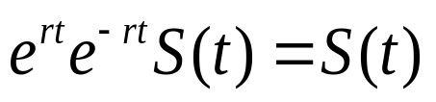
令
Because the discounted asset price is a martingale under
, the second term is .

Slide 17




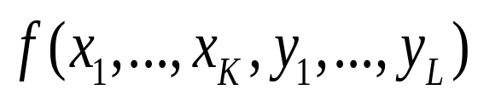


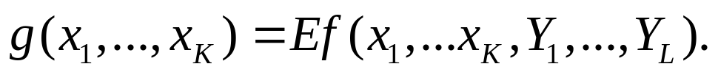
Lemma 2.3.4
Let be a probability space, and let g be a
of F. Suppose the random variables are g-
measurable and the random variables are
independent of g. Let be a function of
the dummy variables and ,and
define
Then

Slide 18
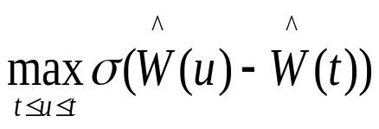
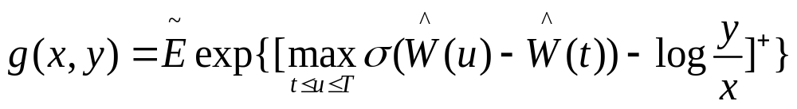


Because Y(t) and S(t) are F(t)-measurable and
is independent of F(t) . We can use Lemma 2.3.4, to write
The conditional expectation as g( S(t) , Y(t)), where
or, equivalently
相同地我們也可以因此求出g(x,y)

Slide 19





Part 1
在7.2時我們已找出 的機率分配，根據課本7.2.6

Slide 20



Part 1

Slide 21


Part 2
在7.2時我們已找出 的機率分配，根據課本7.2.7
第二部分的期望值部分會變成

Slide 22




Part 2
變數變換，設 ，

Slide 23



經過轉換後Part2的第一部分變為
它的界限是
而Part2的第二部分是運用改變積分順序的方法去求
求解

Slide 24



且

Slide 25



雙重積分的第一層為
則Part2的第二部分為
再做一次變數變換

Slide 26




可得
其上限為
並將所有的簡化值做統整，且

Slide 27




再整理一下
根據7.4.3知
所以

